Slide 1
Data Brief Look in to Pandas

Slide 2

What is Pandas?
Python package that works with data structures
Specifically aimed at working with ‘relational’ or ‘labeled’ data
Mainly used for Data Munging
Works nicely with:
Tabular data –SQL tables and Excel Spreadsheets
Ordered and unordered time series data
Arbitrary Matrix Data
Source: http://pandas.pydata.org/pandas-docs/stable/#

Slide 3
Documentation and Tutorials
Documentation:
http://pandas.pydata.org/pandas-docs/stable/index.html
Installation:
http://pandas.pydata.org/pandas-docs/stable/install.html
Link to Tutorials (very helpful!):
http://pandas.pydata.org/pandas-docs/stable/tutorials.html
Developers’ Website – PyData:
http://pandas.pydata.org/
Datacamp Tutorial (good starting point):
https://www.datacamp.com/community/tutorials/pandas-tutorial-dataframe-python#gs.w2AWHh0
Data School YouTube Channel for Pandas:
https://www.youtube.com/playlist?list=PL5-da3qGB5ICCsgW1MxlZ0Hq8LL5U3u9y
Greg Reda tutorial to data structures (very interesting):
http://www.gregreda.com/2013/10/26/intro-to-pandas-data-structures/

Slide 4
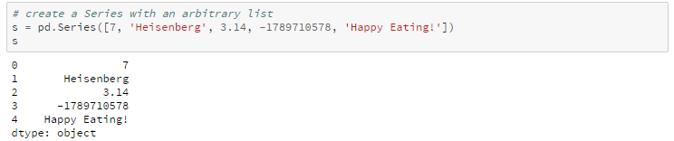
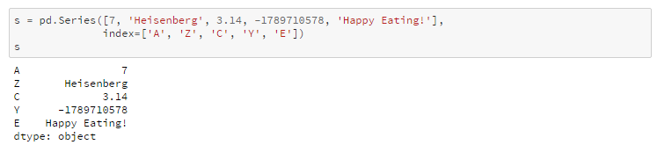
Data Structures in Pandas – Series (1)
One-dimensional object similar to an array, list, or column in a table
Will assign a labeled index to each item in the Series:
Or index can be specified:
Source: http://www.gregreda.com/2013/10/26/intro-to-pandas-data-structures/

Slide 5
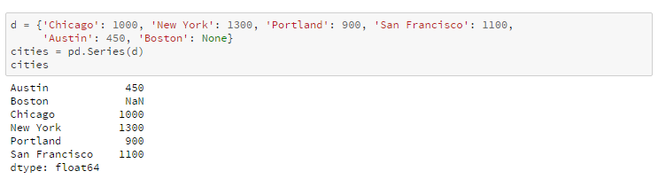
Data Structures in Pandas – Series (2)
Can be constructed from a dictionary as well:
Can carry out:
Specific items indexing – cities[‘Chicago’] or cities[‘Chicago’, ‘Portland’]
Boolean indexing – cities[cities < 1000]
Changing values – cities[‘Chicago’] = 1400
Mathematical operations – cities/3
Checking content - ‘Seattle’ in cities
Source: http://www.gregreda.com/2013/10/26/intro-to-pandas-data-structures/

Slide 6
Data Structures in Pandas – Data Frame
Tabular data structure comprised of rows and columns, similar to a spreadsheet, database table, or R's data.frame object
Can also think of a DataFrame as a group of Series objects that share an index (the column names)
Is the most common type of data structure used for most of the data munging, and we will be spending a bit more time with Data Frames
Created using – pd.DataFrame()
Documentation:
http://pandas.pydata.org/pandas-docs/stable/generated/pandas.DataFrame.html
Source: http://www.gregreda.com/2013/10/26/intro-to-pandas-data-structures/

Slide 7
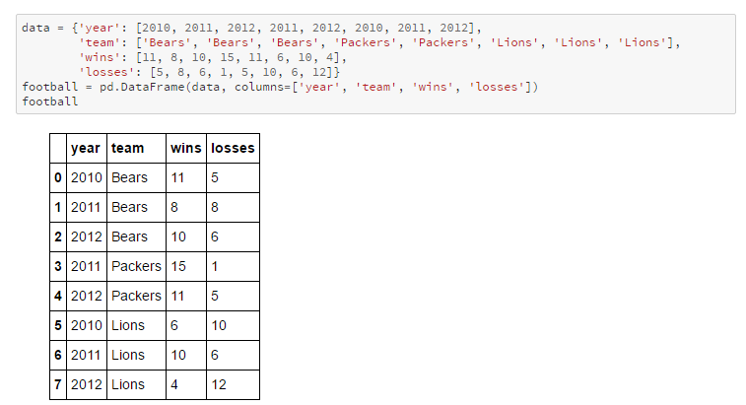
Reading and Writing Data (1)
Creating a DataFrame using direct data input:

Slide 8
Reading and Writing Data (2)
Reading from a CSV file – read_csv()
Example - data = pd.read_csv(‘hello.csv’)
http://pandas.pydata.org/pandas-docs/stable/generated/pandas.read_csv.html
Similar useful functions:
read_fwf() – reads files with fixed widths
read_table() – reads text tables and can guess separators
Writing to a CSV file – to_csv()
Example = data.tp_csv(‘mydata/data.csv’)
http://pandas.pydata.org/pandas-docs/stable/generated/pandas.DataFrame.to_csv.html
Similar useful functions:
to_sql() – writes data into sql table
to_JSON() – writes data to JSON

Slide 9
Describing Data
Getting the name of column names:
list(df.columns.values)
Looking at the type of data for each of the columns:
df.dtypes
Looking at first 5 rows:
df.head()
Number of rows and columns:
df.shape
Number of dimensions:
df.ndim

Slide 10
Converting Data
Converting columns at a go:
df.convert_objects()
Documentation - http://pandas.pydata.org/pandas-docs/stable/generated/pandas.DataFrame.convert_objects.html
To specific type:
df.to_datetime() – converts columns to date/time format
df.to_numeric() – converts columns to numeric format
Similar function:
df[‘column1’].astype(‘float’) – converts column 1 to float. Instead of float, string or other functions can be used

Slide 11
Indexing, Adding and Deleting
Getting specific rows:
df[3:10]
Getting specific rows for specific columns:
df[[‘column1’,’column2]][:10]
Adding columns:
df[‘new column’] = mylist
Deleting columns:
df1= df.drop(‘column5’)

Slide 12
Data Slicing
Boolean queries:
df1 = df[df[‘Income’] >= 1000] – getting incomes higher than or equal to 1000
df1 = df[df[‘Income’] == df[‘Income’].max()] – getting only the highest income entries
Joint queries:
df1 = df[(df[‘Income’] < 50000) & (df[‘Age’] > 20)] – getting the rows with income less than 50,000 and age greater than 20

Slide 13
Handling Missing Data
Finding out whether a row or a column has missing data:
df.isnull()
Dropping the rows with missing data:
df.dropna
Replacing missing data with certain values:
df.fillna(0) – in this case all missing data will be given the value of 0

Slide 14
Now lets get our hands dirty!

